Slide 1
Part 1 Overview of NGS technologies and platforms

Slide 2
Terminology
NGS Next Generation Sequencer (or Sequencing)
Sequence read The nucleotide sequence that comes from a single DNA fragment (on a next-generation sequencer)
Read Pair / Mate pair Two reads from both ends of a DNA fragment, read pairs at distance of several 100 bp or several kb (mate pairs)
Adapter Synthetic sequences added to isolated DNA fragments to help in the amplification, sequencing and identification process (ligation)
Multiplexing The mixing of several samples in the sequencing process where sequences can be assigned later on to the correct sample through the use of barcodes (or indices)
Base calling The process in which base identities are inferred from (light) intensity signals

Slide 3
layout
Sequencing (a short history)
Main NGD sequencing platforms
The Illumina platform
Sequencing strategies

Slide 4
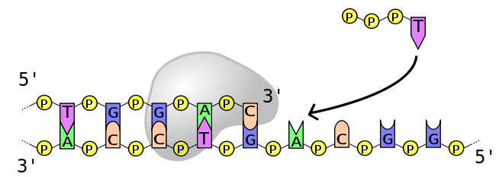
Sequencing by synthesis
These are the ingredients of many sequencing technologies
dNTPs
DNA polymerase
Primer
ssDNA template

Slide 5
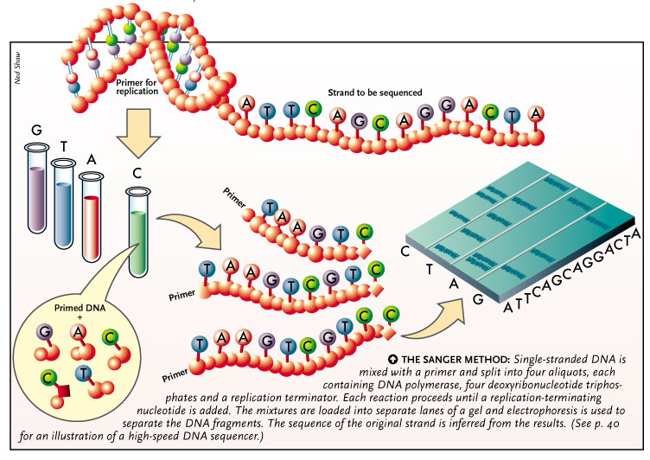

Slide 6
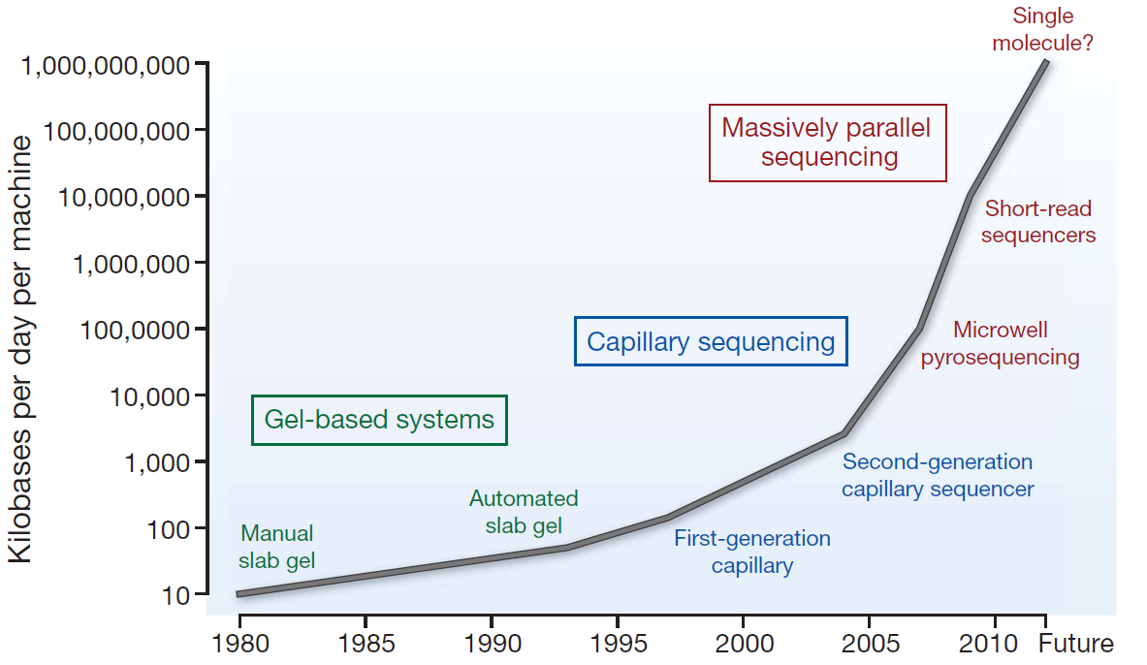
Sequencing (r)evolution
Stratton, nature 458, 719-724, 2009

Slide 7
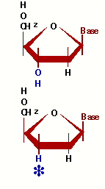
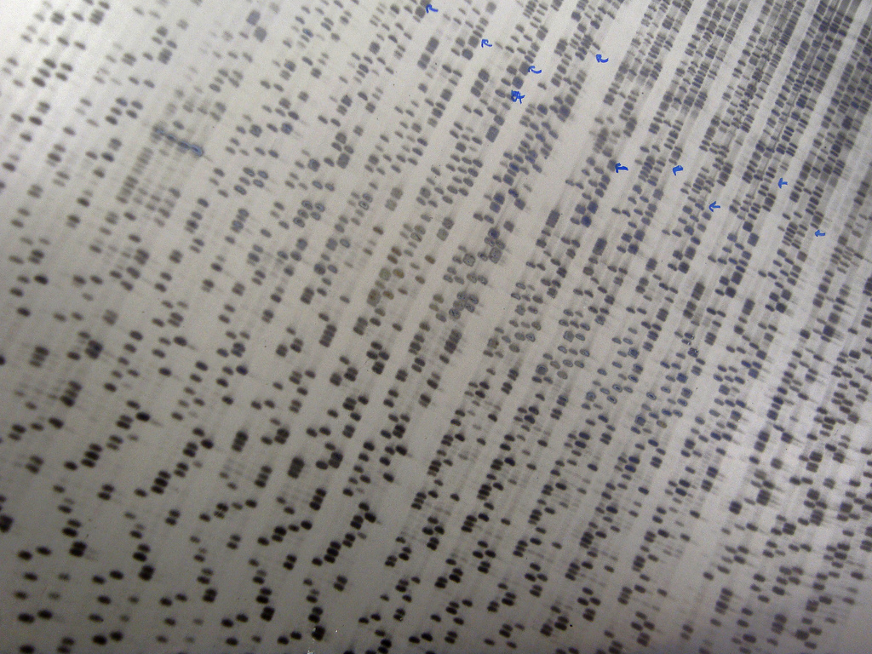
Gel based sequencing
Amplification stops when a Dideoxynucleotide is integrated

Slide 8
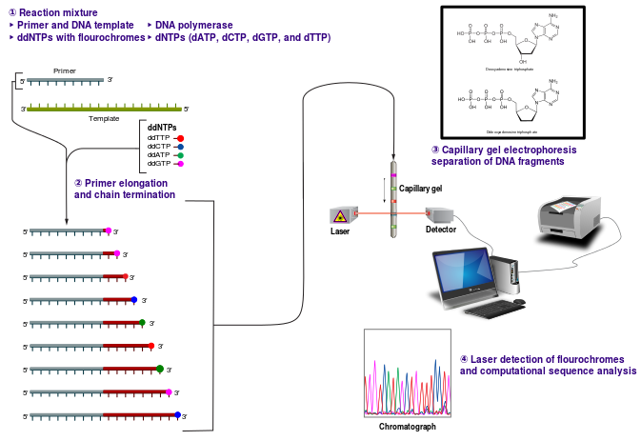
Capillary sequencing

Slide 9
Massive parallel sequencing = Next Generation Sequencing

Slide 10
NGS
Denotes the family of sequencing platforms that have in common their high degree of parallelization and massive data generation.
NGS refers to the sequencing techniques that have succeeded Sanger (dideoxy) sequencing
An unlucky name, since a new generation after NGS is already around (→ NNGS?)

Slide 11
What NGS technologies DON’T offer is: targeted, high accuracy sequencing of small regions
What NGS technologies DO offer is: massive data generation of whole genomes, chromosomes, transcriptomes, exomes etc.

Slide 12
Sequencing technologies: goals
More data for less money
Longer reads!!

Slide 13
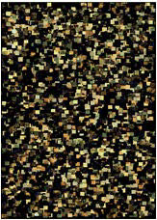
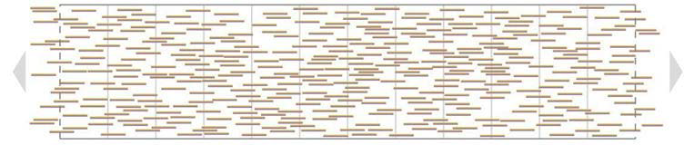

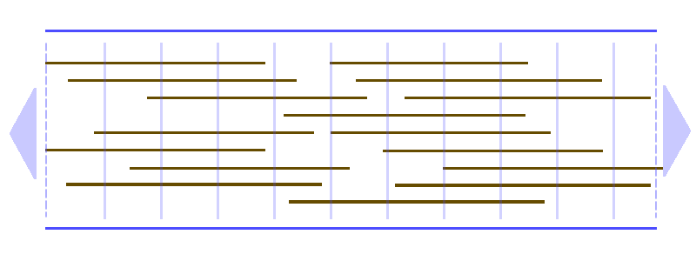
The read length race
Why are longer reads so desirable?

Slide 14
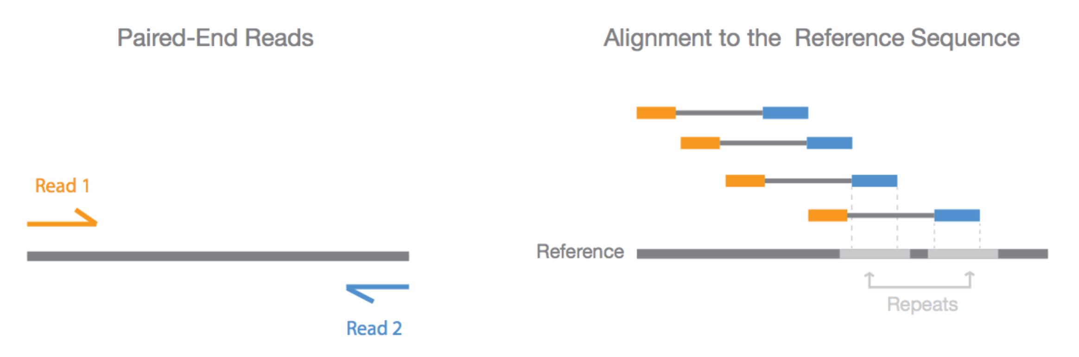
Why read pairs?
In Paired-end sequencing, both ends of the DNA fragment are sequenced
Because the distance between each paired read is known, alignment algorithms can use this information to map the reads over repetitive regions more precisely.
www.illumina.com

Slide 15
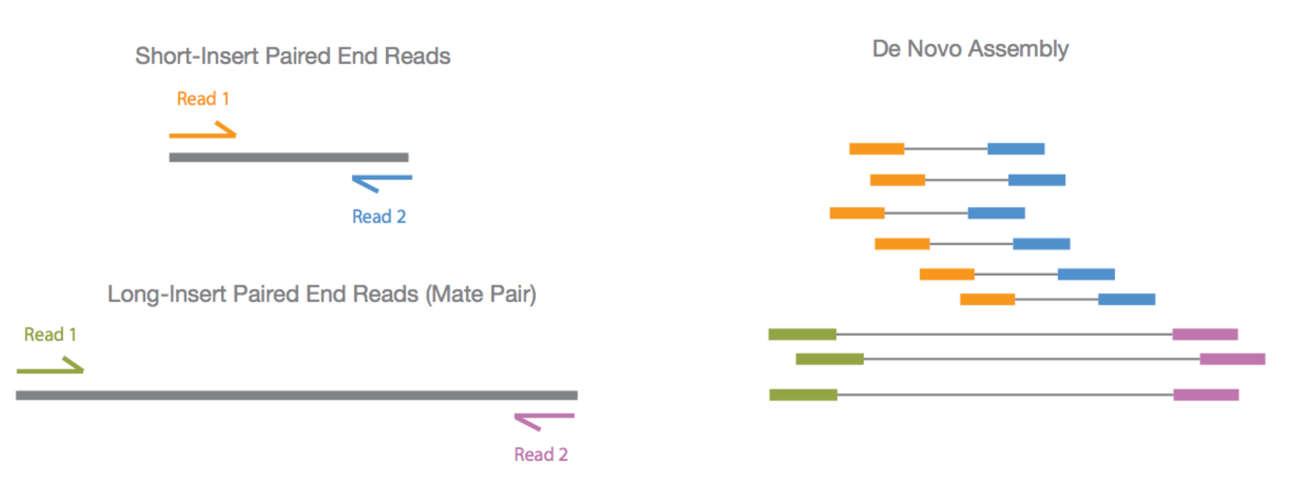
Read pairs versus Mate pairs
Because larger inserts can pair reads across greater distances, they provide a better ability to read through highly repetitive sequences and regions where large structural rearrangements have occurred
www.illumina.com

Slide 16
Main NGS sequencing platforms
Single-molecule real-time sequencing
(Pacific Bio)
Ion semiconductor (Ion Torrent sequencing)
Pyrosequencing (454)
Sequencing by synthesis (Illumina)
Sequencing by ligation (SOLiD sequencing)

Slide 17
Comparison of next-generation sequencing platforms

Slide 18
Principles of 2nd generation NGS sequencers
Clonal amplification
Emulsion PCR → Roche / Ion Torrent
Bridge PCR → Illumina
Sequencing in cycles (Short reads)
454
Illumina
Ion Torrent/Proton

Slide 19
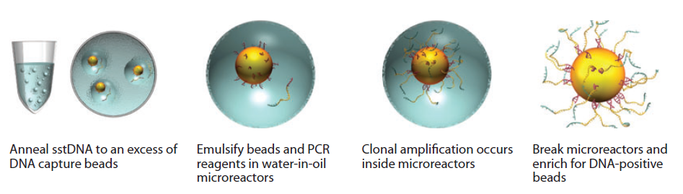
454 (Roche), SOLiD and Ion Torrent use Emulsion PCR for amplification

Slide 20
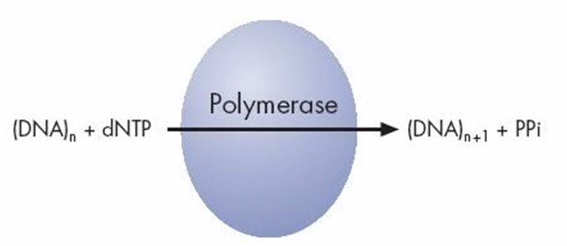
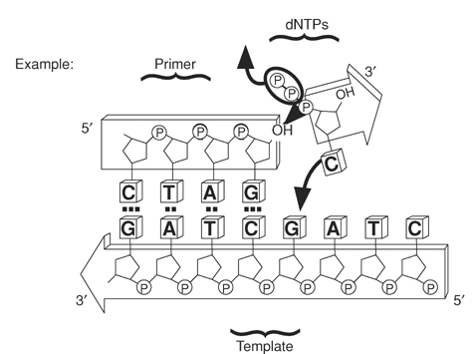
Roche 454: pyrosequencing
PPi

Slide 21
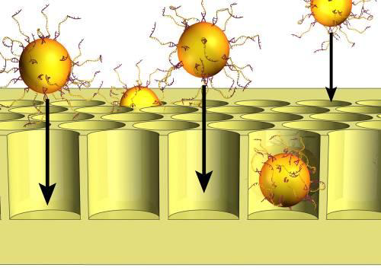
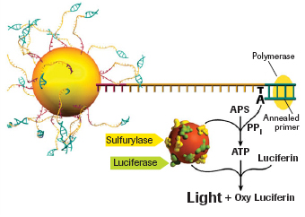
Roche 454: pyrosequencing
APS = Adenosine 5’-phosphosulfate

Slide 22
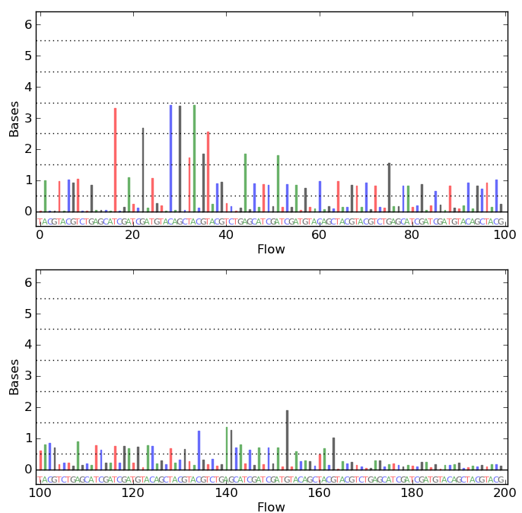
Roche 454: pyrosequencing
The big weakness of 454 sequencing: homopolymers give fast increasing error rate with increasing length
mammoth.psu.edu
Notes:
What are the downstream effects when analyzing a read with (long) homopolymer?

Slide 23
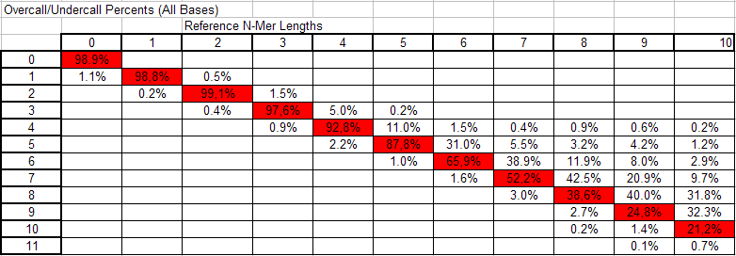
The Roche 454 homopolymer problem
movie
Notes:
Column 1 does not add up to 100%!

Slide 24
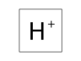
Ion Torrent sequencing
+H⁺
PPi

Slide 25
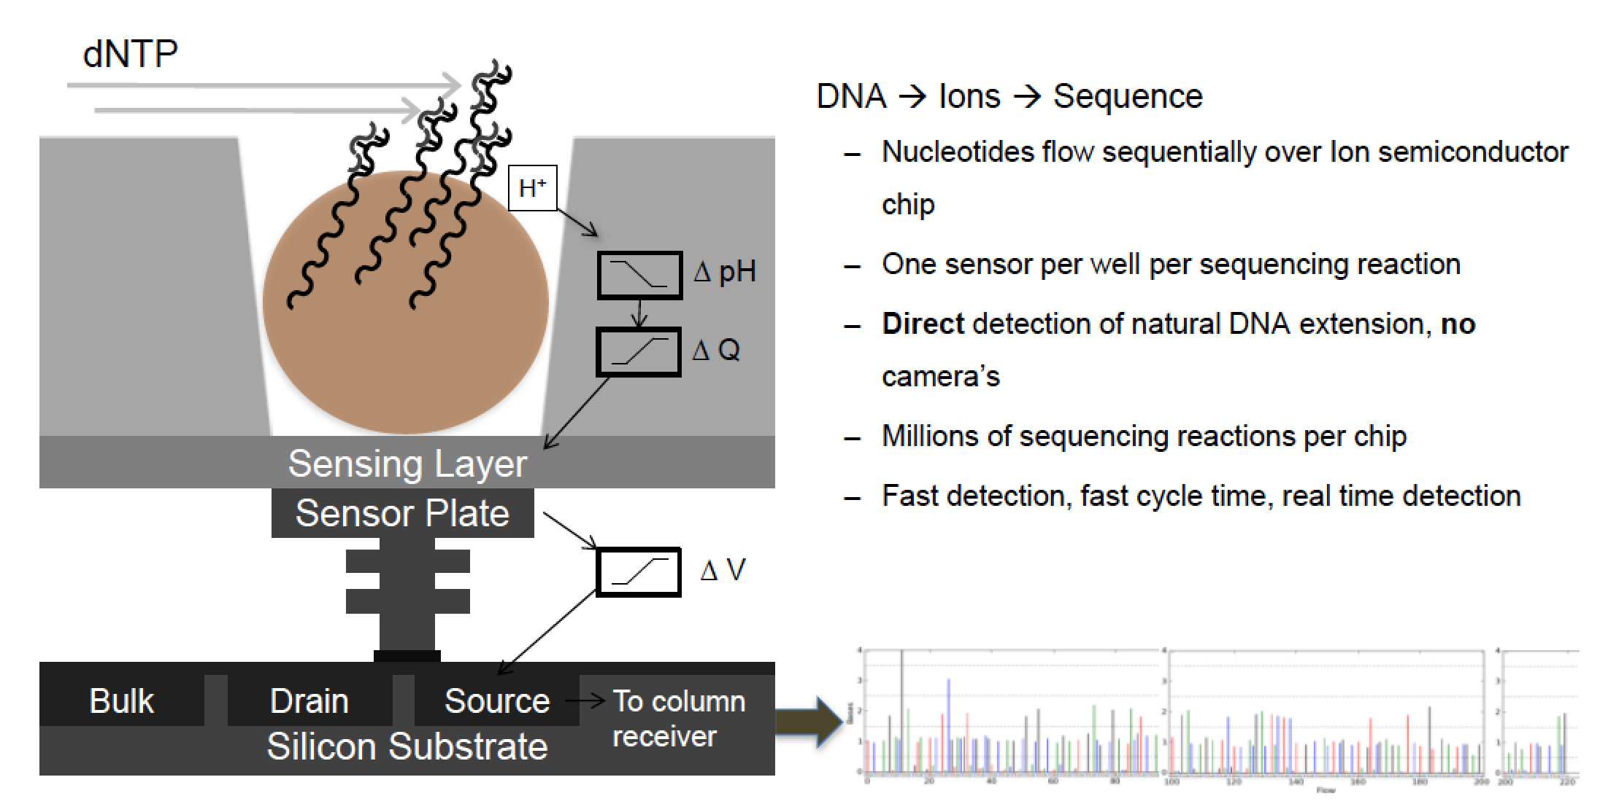
Ion Torrent sequencing
movie

Slide 26
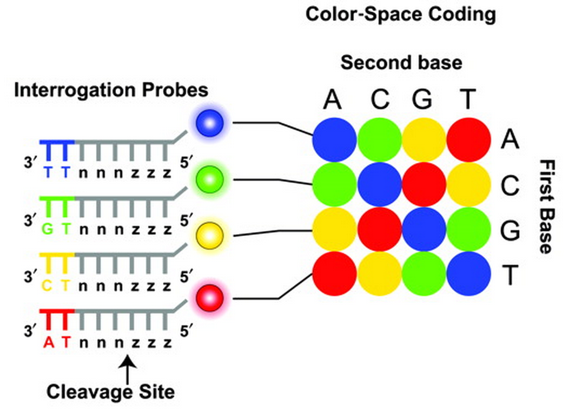
SOLiD sequencing
Sequencing by ligation
1600 million (!!) reads per run (160 Gb data)
Max 75 bases read length
Does not sequence bases but rather dinucleotidess

Slide 27
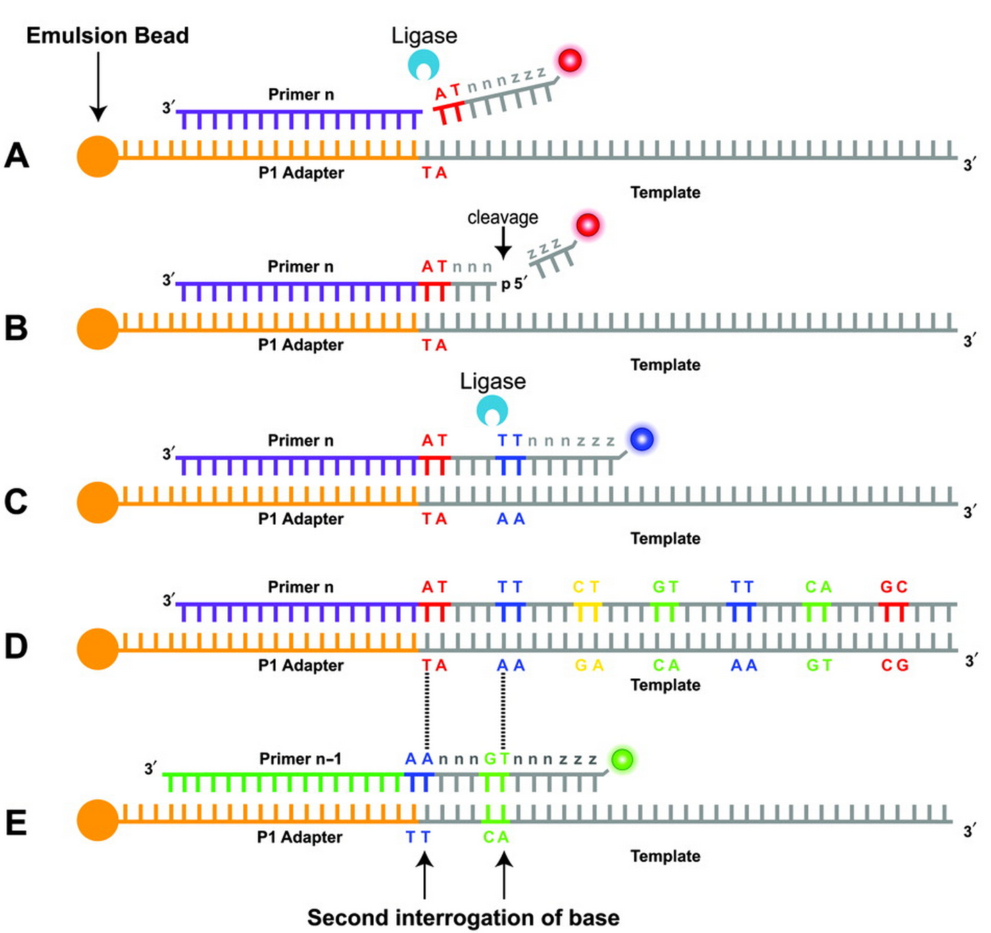
SOLiD sequencing

Slide 28
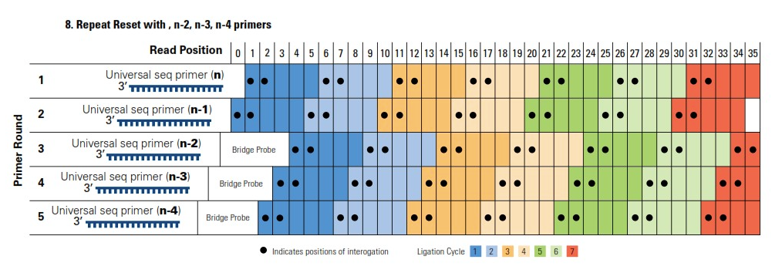
SOLiD sequencing

Slide 29
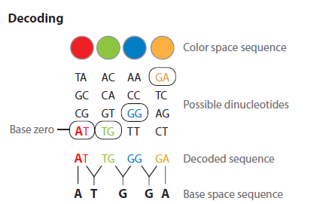
SOLiD sequencing
movie

Slide 30
Single molecule sequencers
PacBioRS
Oxford Nanopore
Helicos
No amplification required for the reads
Longer Read (excluding Helicos)
Base modification detection (excluding Helicos)

Slide 31
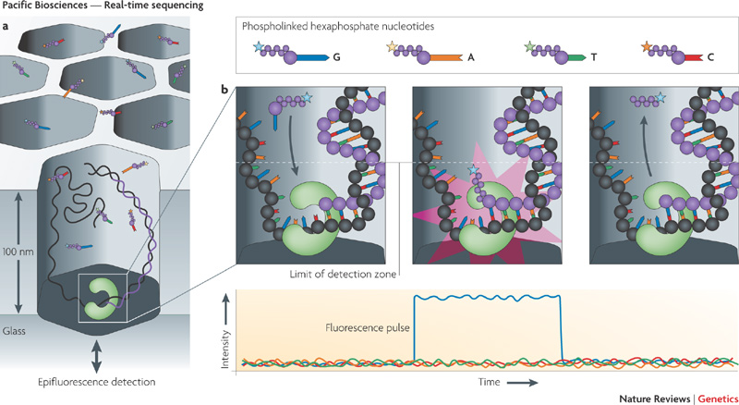
Single molecule sequencers - PacBio
2-3 kb single continuous read!
High (>10%) error rate!
movie

Slide 32
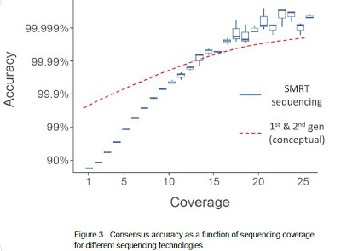
Is a high error rate bad per se?
Not with high coverage
Not with low systematic error rate!
Notes:
Coverage for mutation call in Diagnostics department minimum 5 (in Nextgene) and 20 in Cartagenia. Average coverage 300!

Slide 33
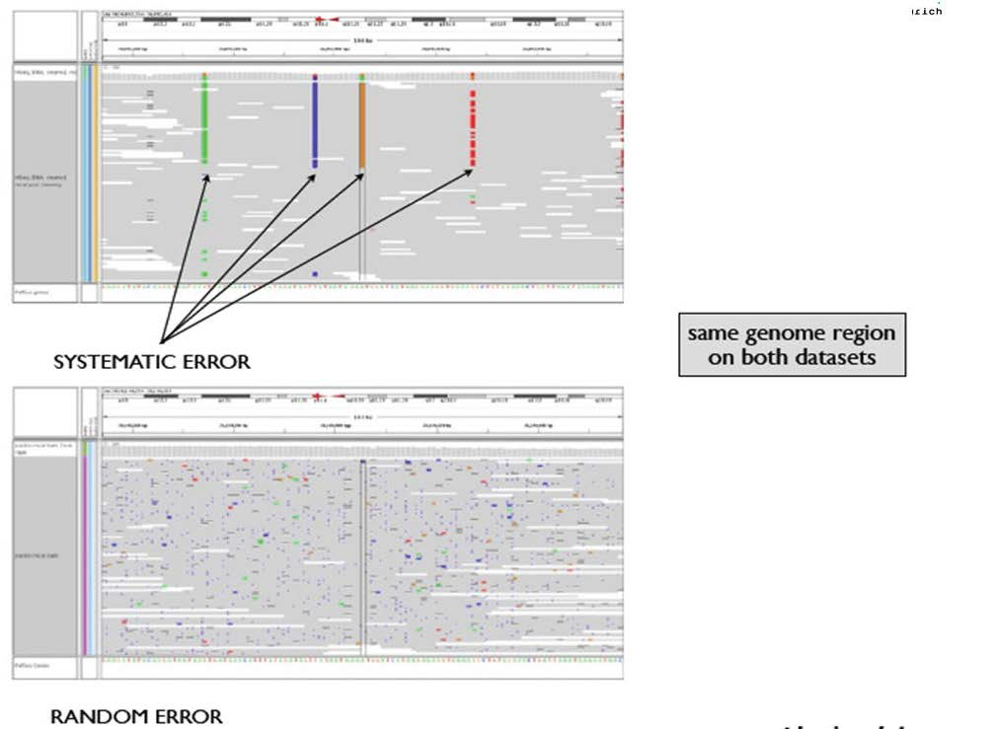
Systematic versus random errors
HiSeq
PacBio

Slide 34
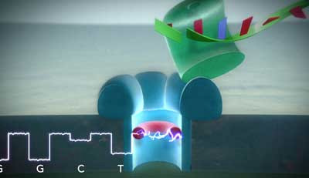
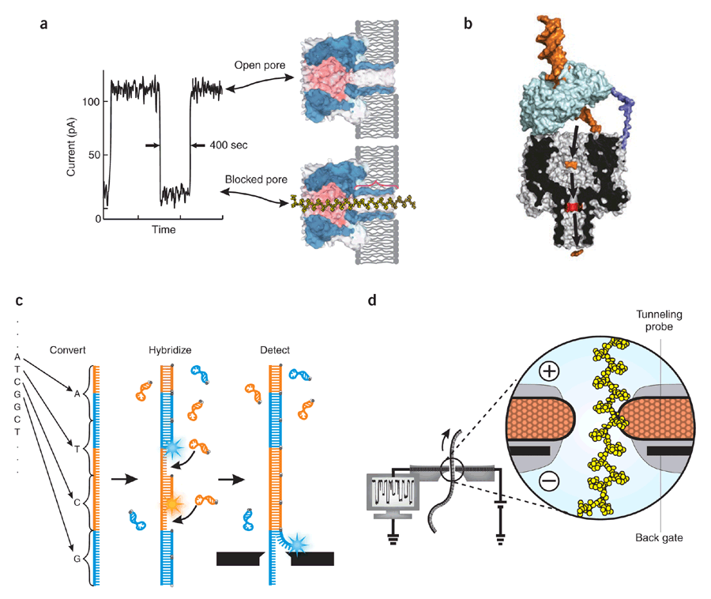
Single molecule sequencers – Oxford Nanopore
No enzyme
or label!
movie

Slide 35
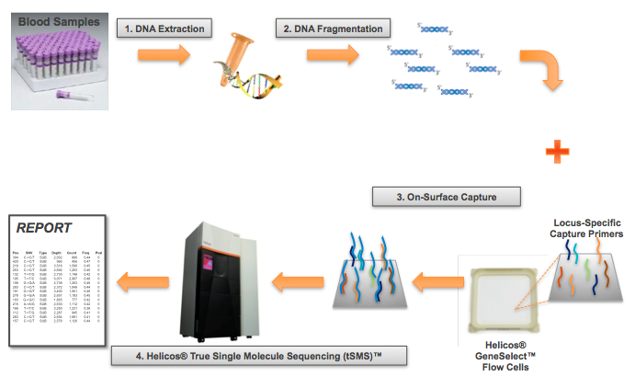
Helicos sequencing
Movie

Slide 36
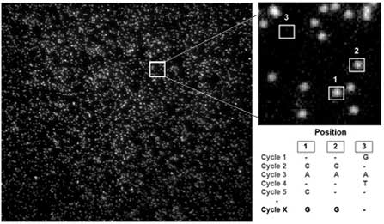

Slide 37
Single Molecule Sequencing = the future
Nanopores with electrical real-time analysis and without the need for optics, labels, amplification or fluidics looks like the next level of sequencing
But needs
Increased number of reads per run
Improved accuracy
Decreased reagent costs

Slide 38
Part 2 Overview of NGS technologies and platforms

Slide 39
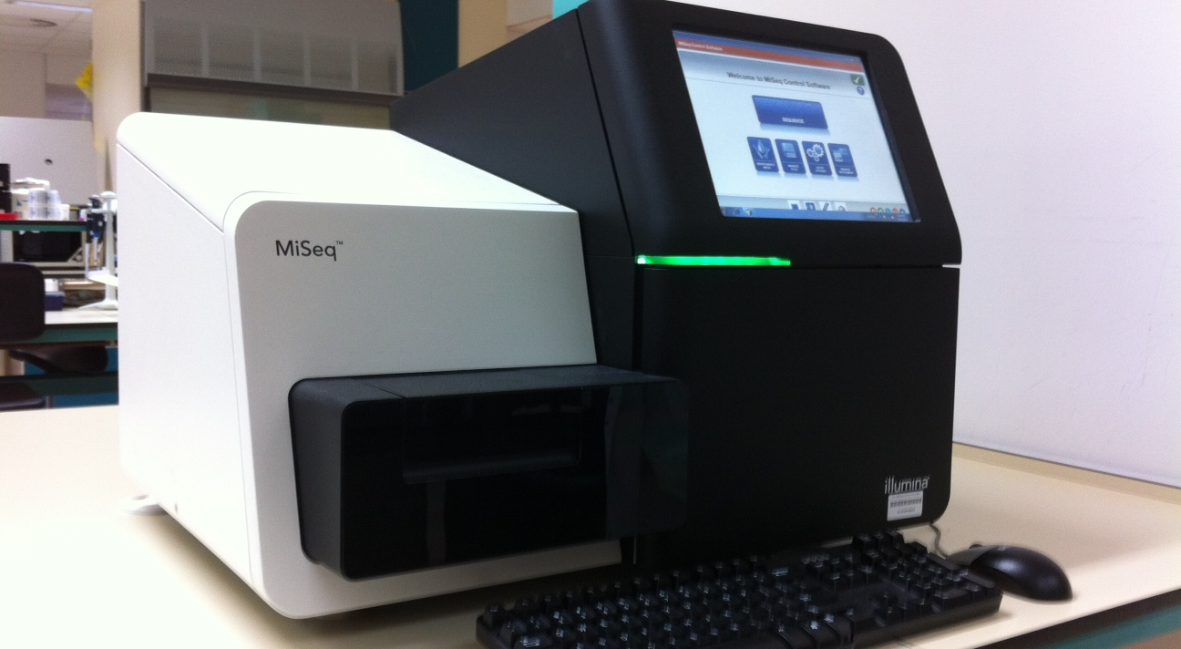
The Illumina platform
umcg/genetics

Slide 40
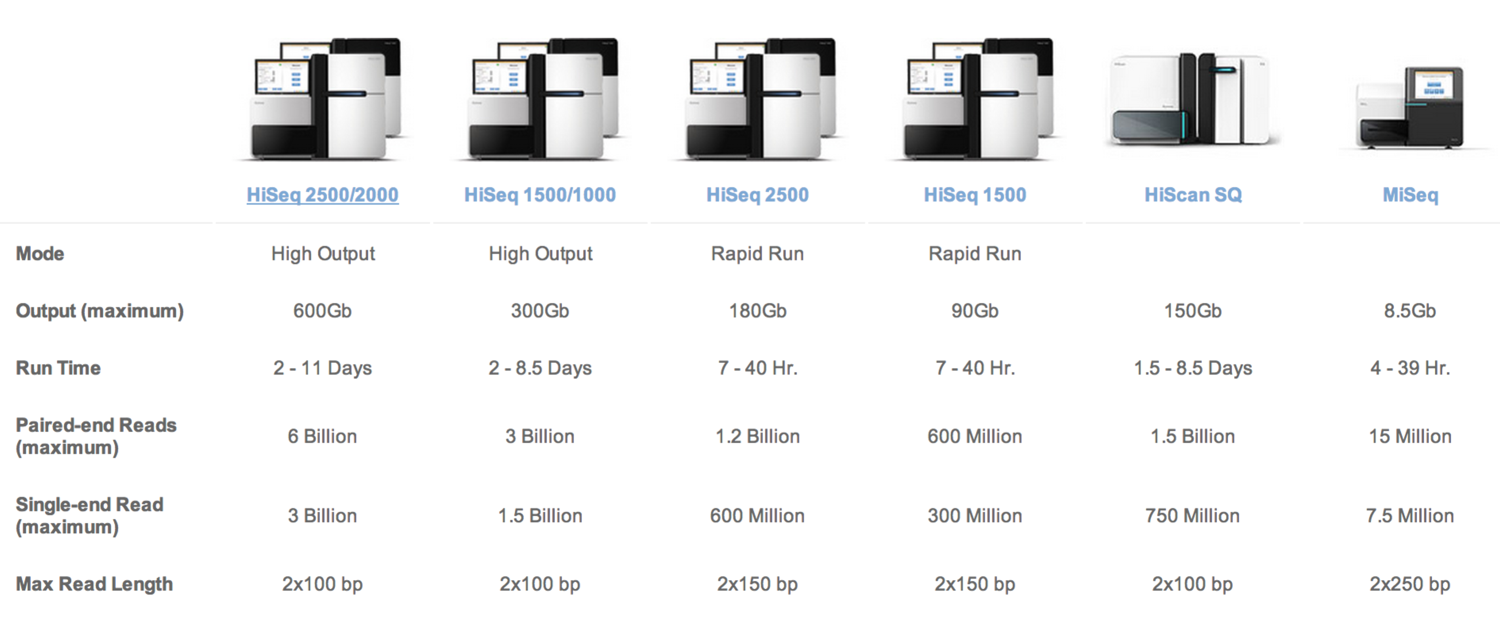
A sequencer for every need
www.illumina.com

Slide 41
The stages in Illumina sequencing
Sample preparation & target enrichment
Sequencing
Data processing

Slide 42
Sample preparation for Illumina
DNA isolation
QC on DNA prep
Fragment/shear DNA
Adapter ligation
Size selection (300-350 bp)
Amplification (=PCR) of selected fragments
QC of amplified material

Slide 43
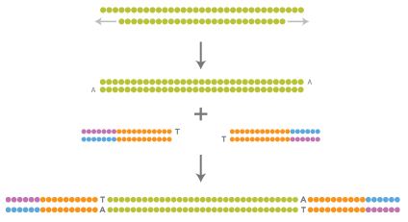
DNA processing summary
Repair and add Adenine overhang
Ligate adapters
Platform-specific oligonucleotide adapters, needed to perform the sequencing biochemistry and index samples, are ligated to each end of the fragments to yield the sequencing-ready library
www.illumina.com

Slide 44
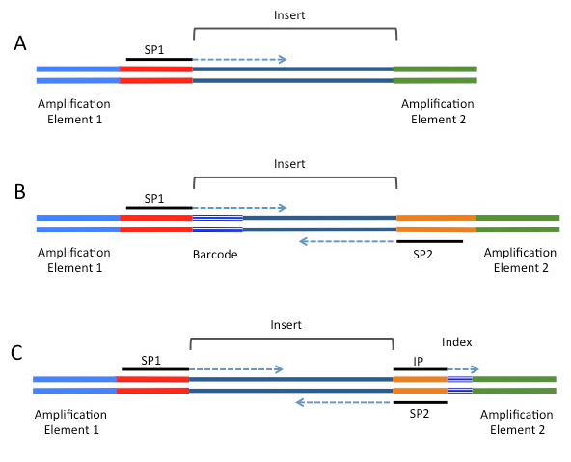
Adapters up close
Elements that can be included in NGS adapters on the Illumina platform.
SP1=primary sequencing primer; SP2=paired-end primer; IP=sequencing primer for the index read.
(A) Minimal adapter components. (B) Barcode configuration supporting a paired-end read. (C) Index configuration supporting a paired-end read.
Index’s can be used for upfront de-multiplexing
http://rnaseq.uoregon.edu

Slide 45
Optimal Illumina library profiles
Single peak at 340-390 bp (including adapters) with small size distribution
No primers present (peaks < 70 bp)
No empty library present: peak at 125-130 bp

Slide 46
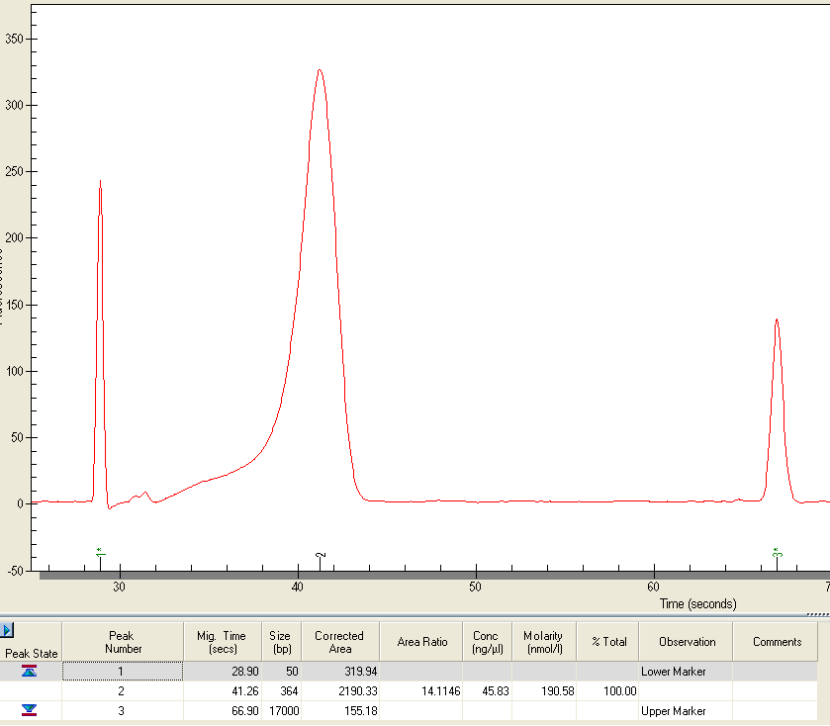
GIGO: Garbage in, Garbage out
364 Bp
Ideal situation!
Primer peaks

Slide 47
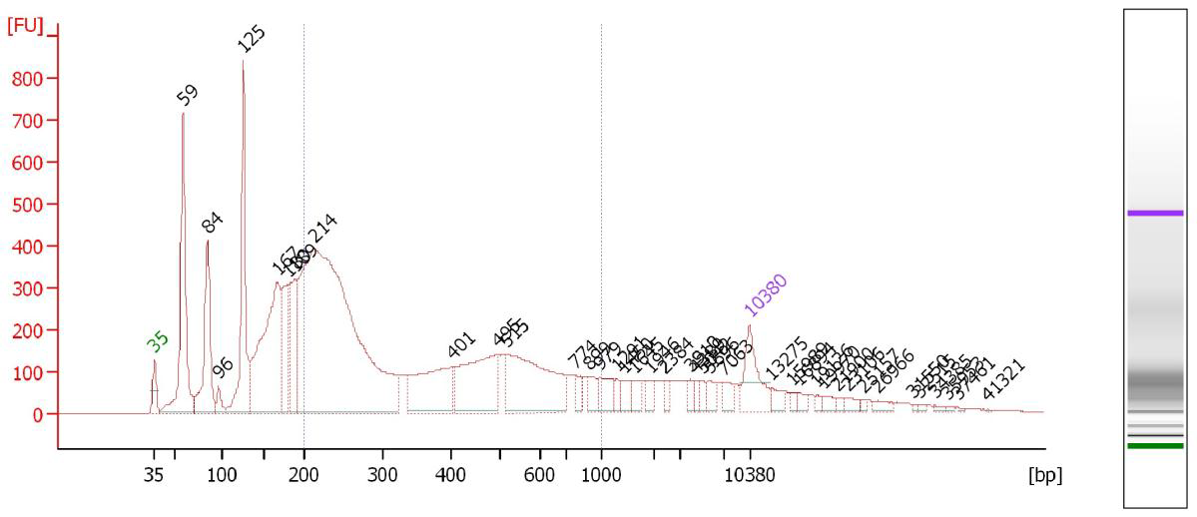
GIGO: Garbage in, Garbage out
Empty library peak at 125 bp
Primer peaks
at 59 & 84 bp
Bad situation!
Do not sequence this
Main peak at 214 bp too short for PE run

Slide 48
Targeted sequencing: Capturing of a panel of genes
Input: Prepped Genomic DNA
Custom made library kit (bait)
Hybridization
Magnetic Beads
Capture beads with magnet
Wash and elute beads
Amplify
QC of captured material
Pooling of 12 samples
Notes:
There are standard library kits available, such as SureSelect Whole Exome kit

Slide 49
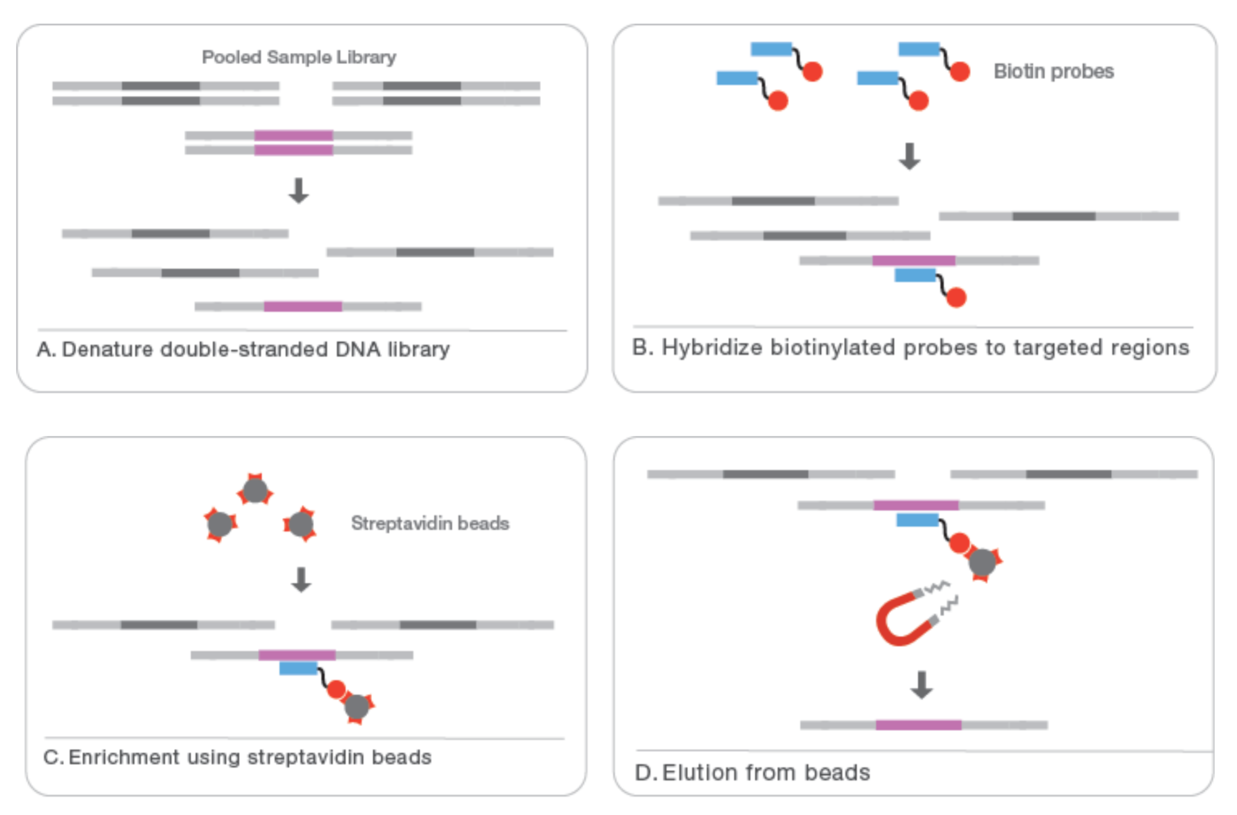
Target enrichment
www.illumina.com

Slide 50
Sample pooling
Since one sequencing lane generates so much data, samples are pooled when less reads per sample are required
A sample-specific unique index (barcode) is added in last amplification step
Index: A 6-mer at an edit or Hamming distance of at least 2 (most 3) from any other index sequence to minimize the chance of mix-ups
Notes:
Not all indexes (or sequences) should start with the same base, otherwise the camera alignment will be problematic

Slide 51
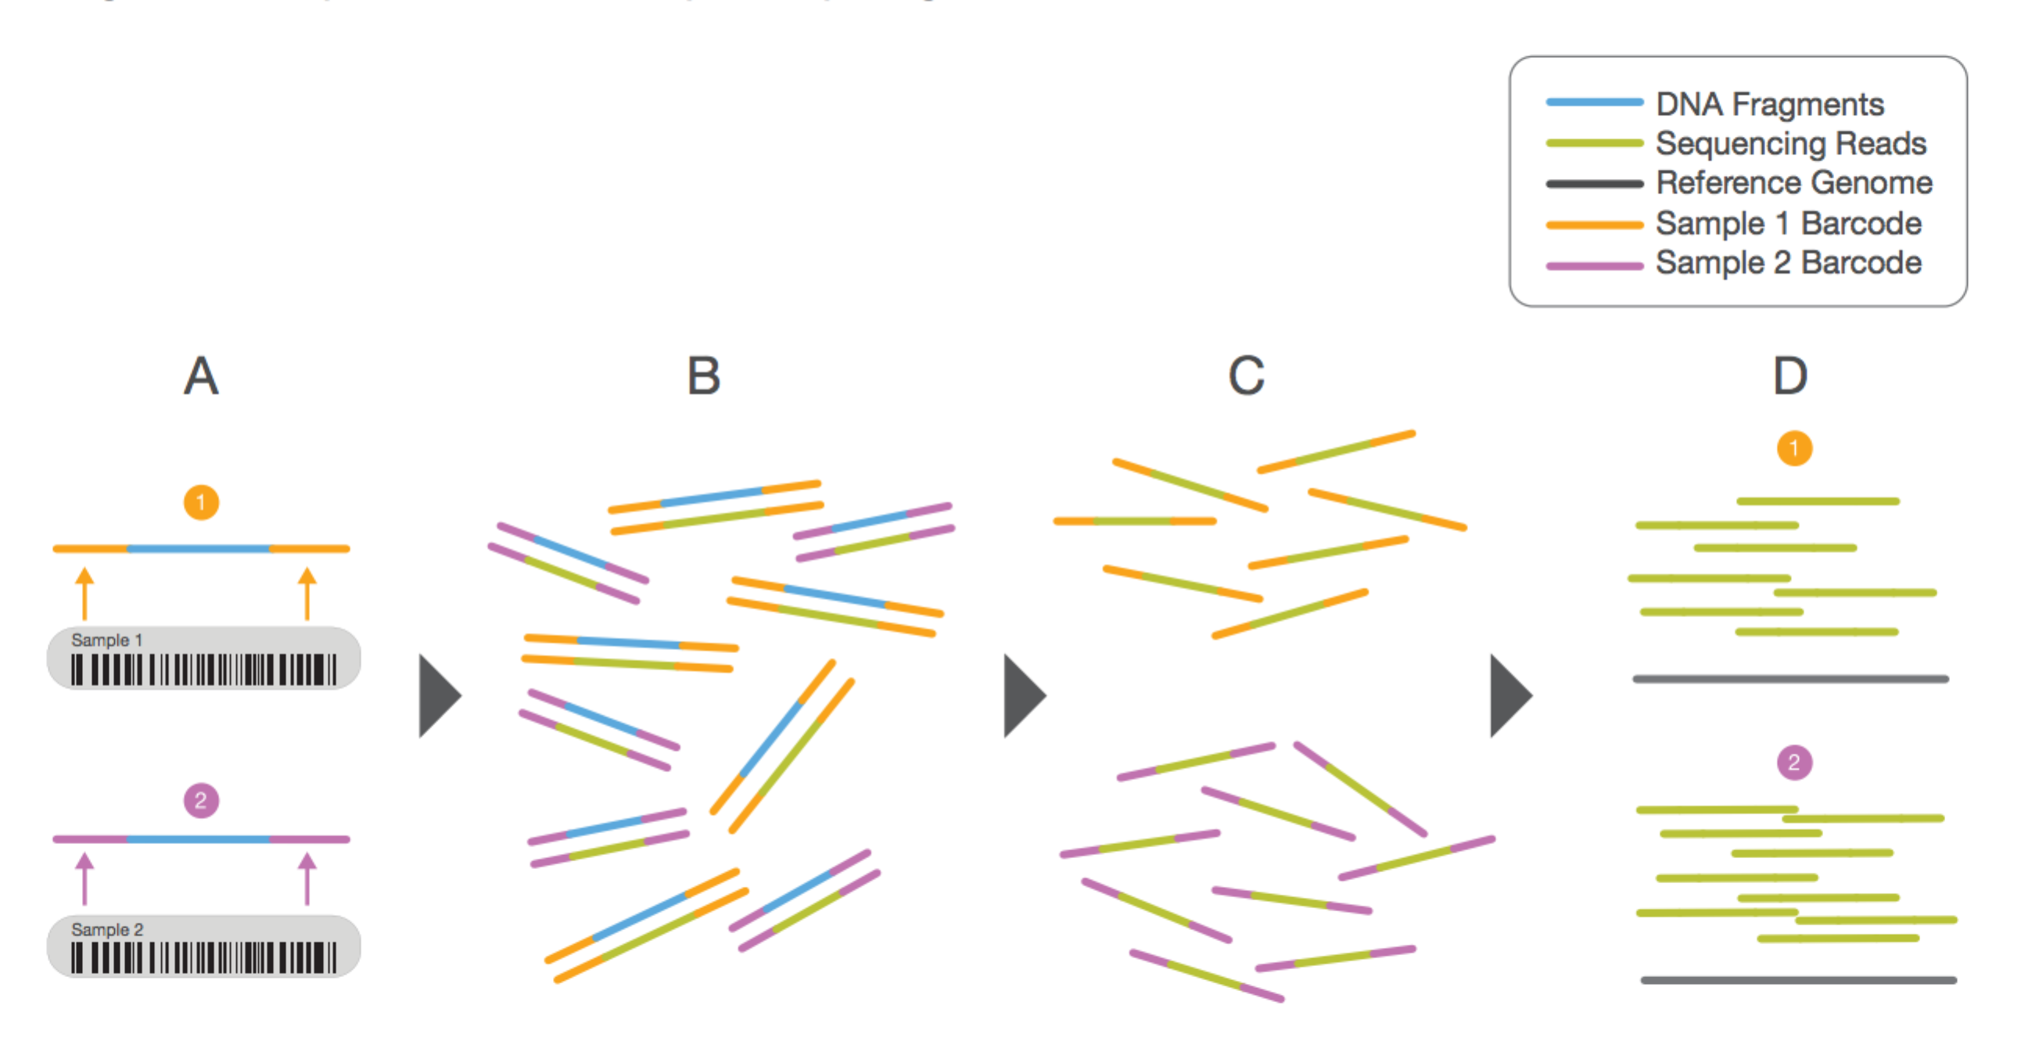
Multiplexing using barcodes
www.illumina.com

Slide 52
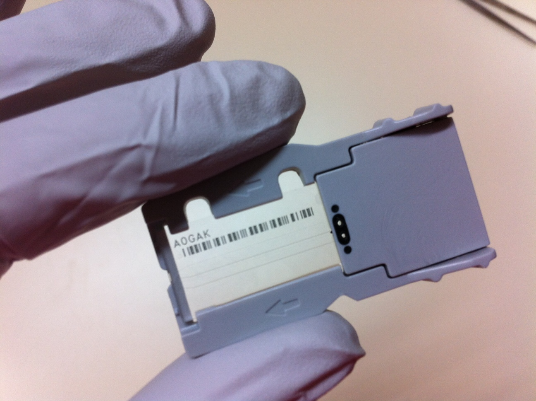
The actual sequencing
The sequencing process on Illumina is a sophisticated process of fluidics
DNA templates are attached to a flow cell
All sequencing steps are performed by flowing reagents over the attached DNA

Slide 53
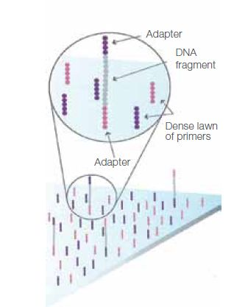
The sequence of sequencing (1)
Attach DNA to flow cell
Bridge amplification to generate clusters
Denaturing and annealing of sequence primers
Sequencing in 100-150 cycles:
Single DNA-fragments are attached to the flow cell by hybridizing to oligos on its surface that are complementary to the ligated adapters

Slide 54
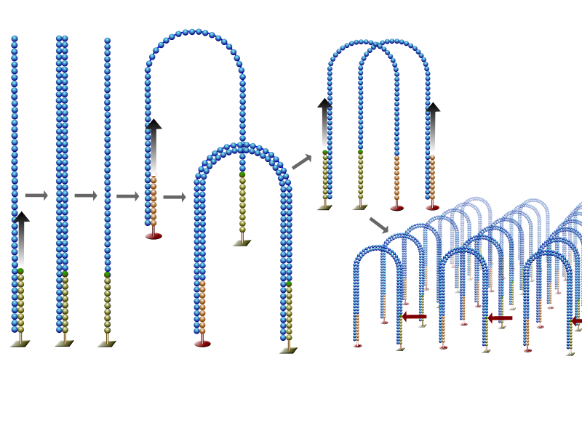
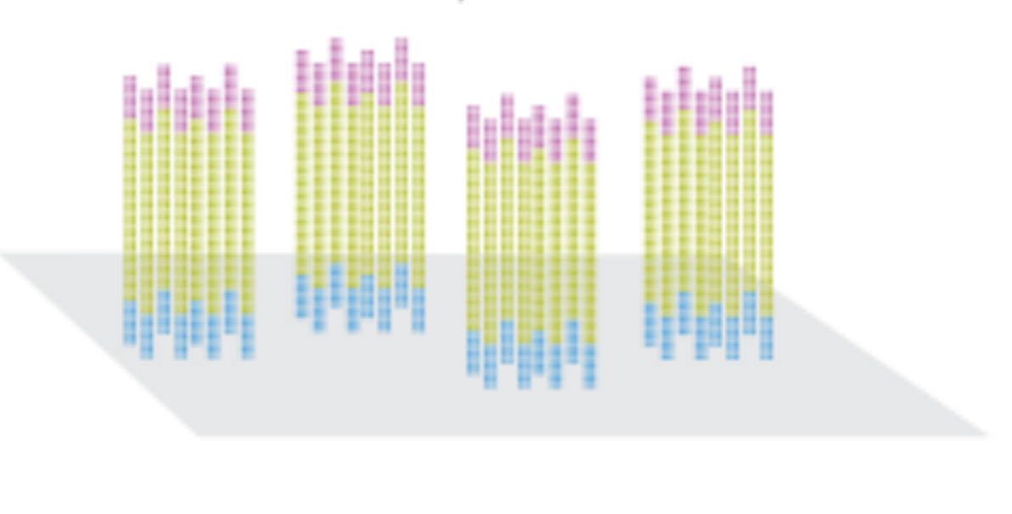
The sequence of sequencing (2)
Attach DNA to flow cell
Bridge amplification to generate clusters
Denaturing and annealing of sequence primers
Sequencing in 100-150 cycles
Bridge amplification yields a high-density unordered array of amplified DNA fragments
Each of these clusters derives from a single unique DNA fragment
www.illumina.com
wikipedia.org

Slide 55
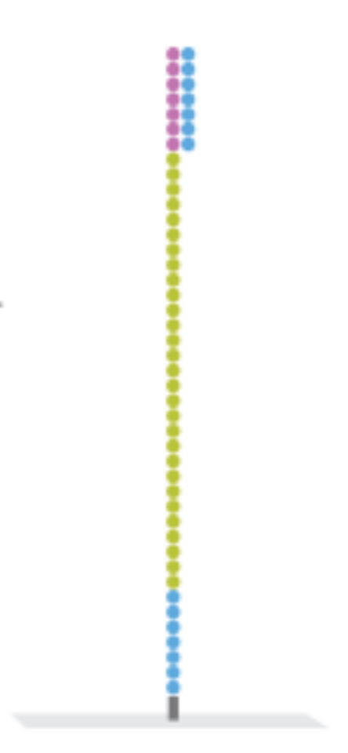
The sequence of sequencing (3)
Attach DNA to flow cell
Bridge amplification to generate clusters
Denaturing and annealing of sequence primers
Sequencing in 100-150 cycles
Annealed sequencing primer
The reverse strands are cleaved and washed away and the sequencing primer is hybridized to the DNA-templates
www.illumina.com

Slide 56
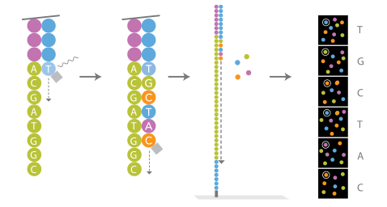
The sequence of sequencing (4)
Attach DNA to flow cell
Bridge amplification to generate clusters
Denaturing and annealing of sequence primers
Sequencing in 100-150 cycles
Each base has its specific fluorescent label
A blocked base is attached to the end of the growing chain (or primer), detected by fluorescence and deblocked for the next cycle
www.illumina.com

Slide 57
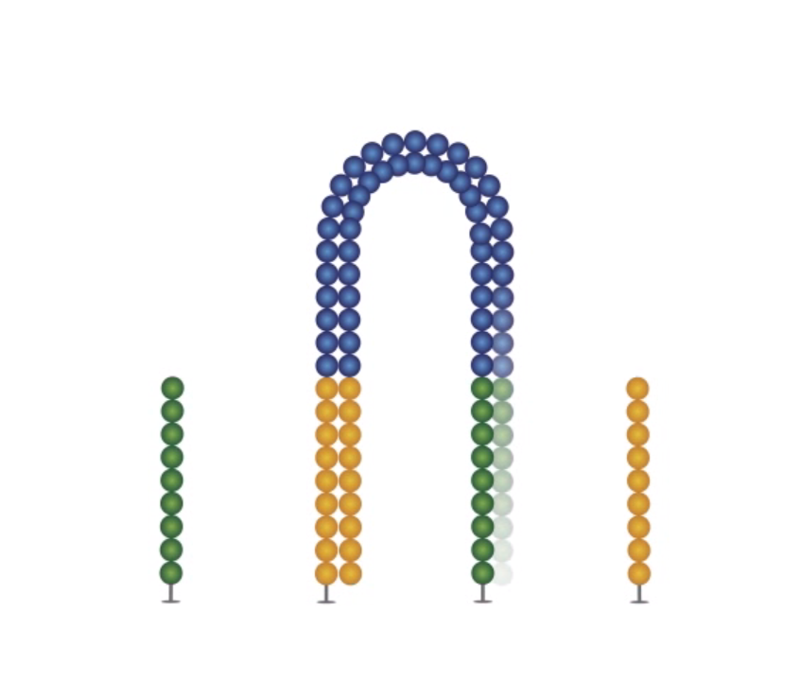
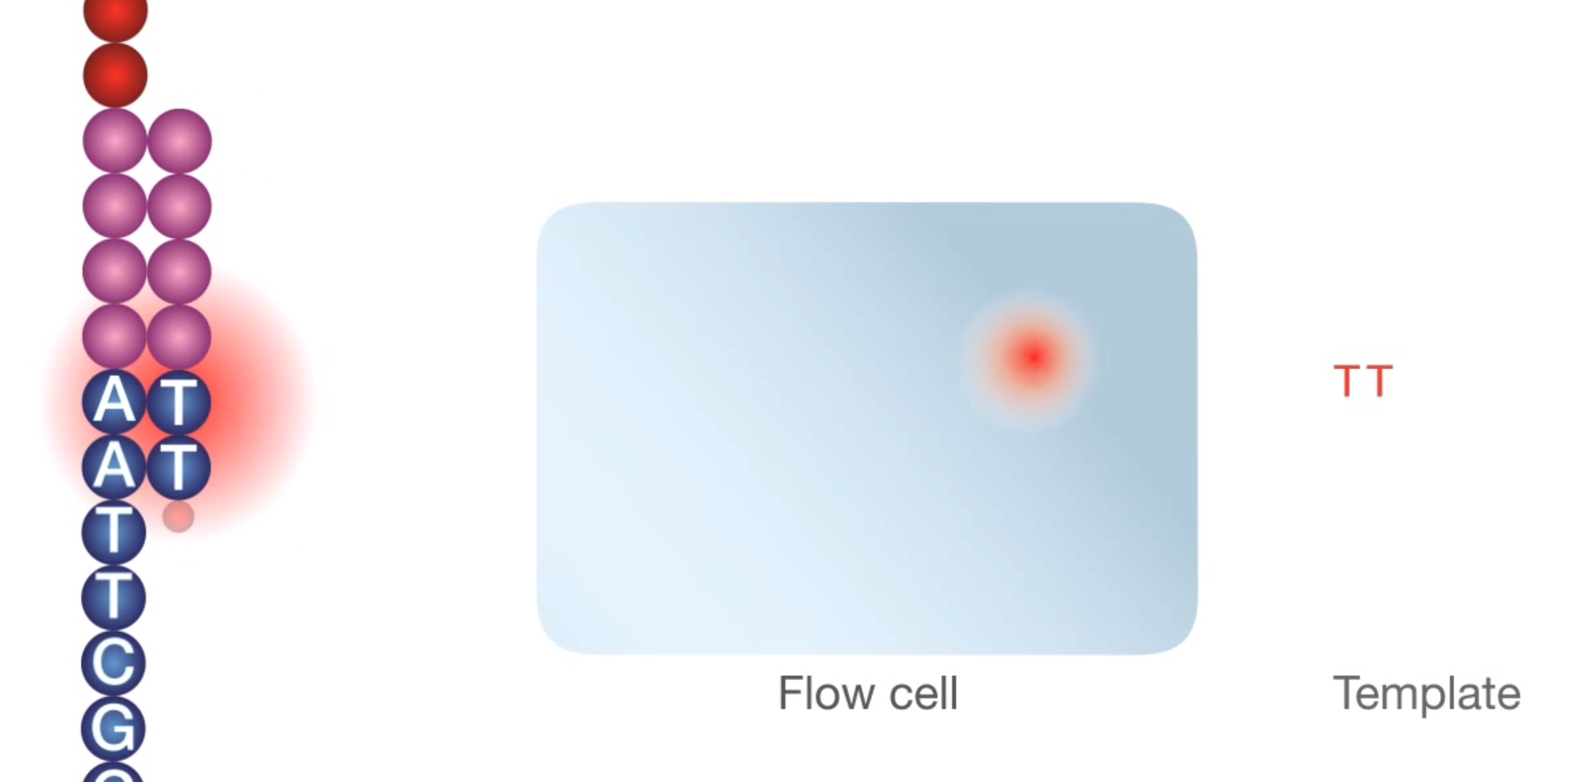
Illumina sequencing movie
movie

Slide 58
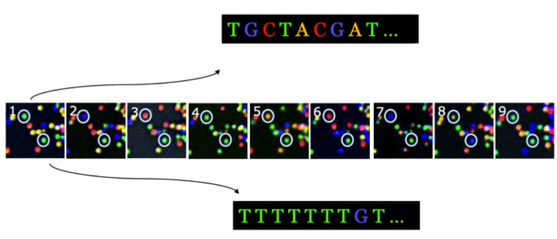
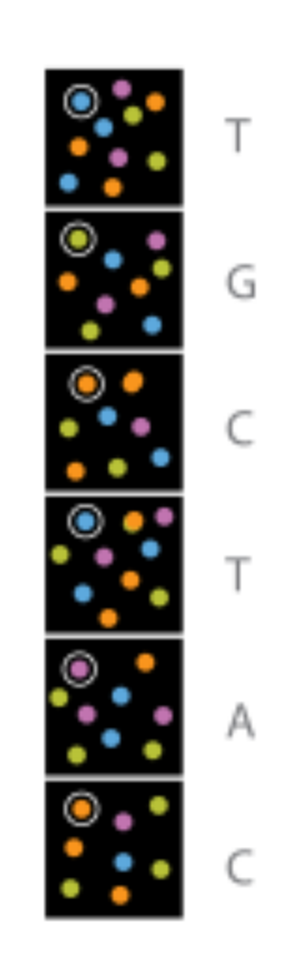
From image to sequence
The raw product of the sequencing reaction is a time-lapse series of images with fluorescent signals in an unordered grid
Theory
Ideal

Slide 59
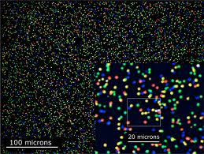
From image to sequence (2)
Practice:
Dust specks
Proximity
Low signal
Noise
Degradation during cycles

Slide 60
From image to sequence (3)
The time-lapse series of images is transformed into a textual representation of nucleotides and the probability of false identity for each nucleotide
We call this process base calling
@HWI-962:64:D0BNFACXX:7:1101:1227:2119 1:N:0:GATCAG
TGCTACGAT
+
CCCFFFII9
@HWI-962:64:D0BNFACXX:7:1101:1176:2147 1:N:0:GATCAG
TTTTTTTGT
+
CCCFFFFFG
Sequence 1
Quality of sequence 1

Slide 61

Minimize technical variance through randomization
Avoid bias: don't order your samples in a logical way !!!
Example for 2 groups with 4 samples each
Notes:
In practice at Diagnostics dept 12 patient samples from same group

Slide 62
Part 3 Overview of NGS technologies and platforms

Slide 63
Sequencing strategies
De novo genomic sequencing
Genomic resequencing
Whole-genome
Target enrichment (exome, gene panel)
Metagenome sequencing
RNA-seq
ChIP-seq
Small RNA (miRNA) sequencing
etc

Slide 64
Pros and cons of targeted sequencing
PROS
Cheaper (while capturing cost < sequencing cost)
Higher coverage
Decreased risk of unsolicited findings
Less variants to analyze

Slide 65
Pros and cons of targeted sequencing
CONS
New gene is discovered → new target set → validation etc + resequencing
You cannot identify new genes or pathways
The capture may introduce (strand) bias
The true variant may be outside the region analyzed (e.g. intronic, UTR)
As sequencing gets cheaper the capture method may become too expensive

Slide 66

Structural Variants and their detection
http://compbio.cs.brown.edu/projects/structvar/

Slide 67

Structural Variants and their detection: deletion & insertion
http://www.nature.com/nrg/journal/v12/n5/images/nrg2958-f2.jpg

Slide 68
Sequencing strategies: RNA-seq
RNA-seq / cDNA sequencing is done to get insight into
gene expression levels
different allele expression
alternative splicing
(alternative) transcription start sites (deepCAGE)
(alternative) polyA site mapping (deepSAGE)
Translation start site identification (Ribosome Profiling / RPF)
(anti)sense expression
Etc

Slide 69
Techniques for expression profiling
A few genes
Northern blot
Quantitative RT-PCR
Genome-wide
Microarrays
RNA-seq
miRNA-seq

Slide 70

RNA-seq (Illumina)
Geospiza.com, edited

Slide 71

Example of RNA-seq (Illumina)
Geospiza.com, edited

Slide 72
ChIP-seq
Chromatin ImmunoPrecipitation
Investigate Protein-DNA interactions

Slide 73

ChIP-seq: study of Transcription Factors
TFs are modular proteins that recognize specific DNA motifs
TFs regulate gene expression, and consequently many important cellular processes
TFs are often mutated or aberrantly expressed in human disease

Slide 74

ChIP-seq overview
Using Formaldehyde
wikipedia.org

Slide 75



Slide 76

ChIP-seq visualization
Find peaks → Peak is binding site of protein

Slide 77
ChIP-seq
Pros:
Protein-DNA interactions are detected as they occur in vivo
Quantitative (qPCR analysis)
Adaptable to genome-wide analysis
Can be performed for all proteins recruited to the DNA
Cons:
Requires suitable antibodies
Extremely inefficient (0.001-0.1% of input is recovered)
Low-affinity binding events are easily missed (antibody dependent)
Not a functional experiment on its own

